Slide 1
UI/UX
Present by ei htet htet htun

Slide 2
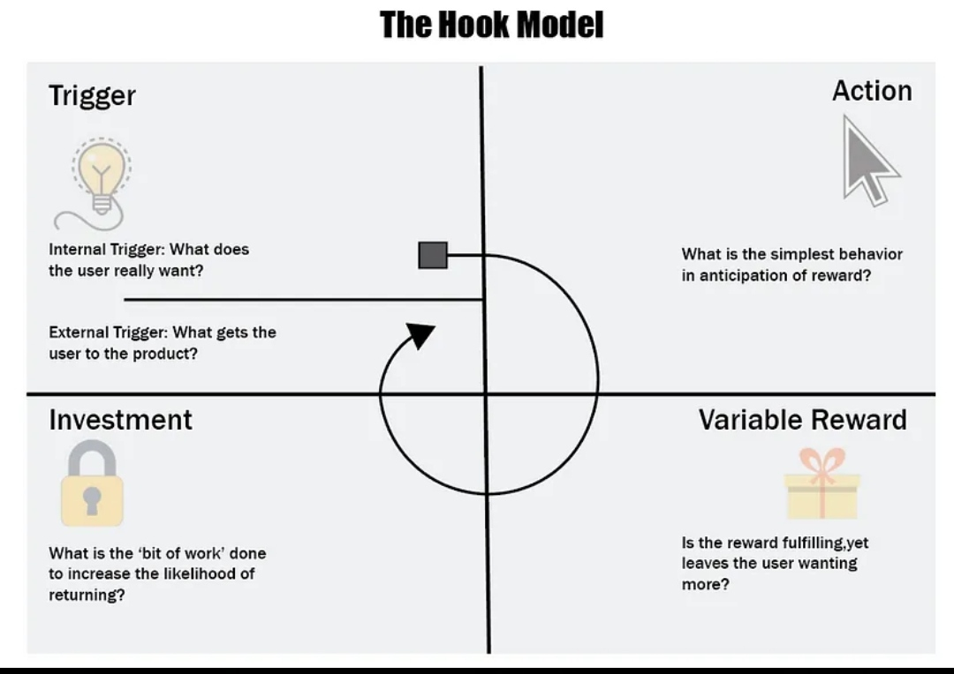
What is hook model?

Slide 3
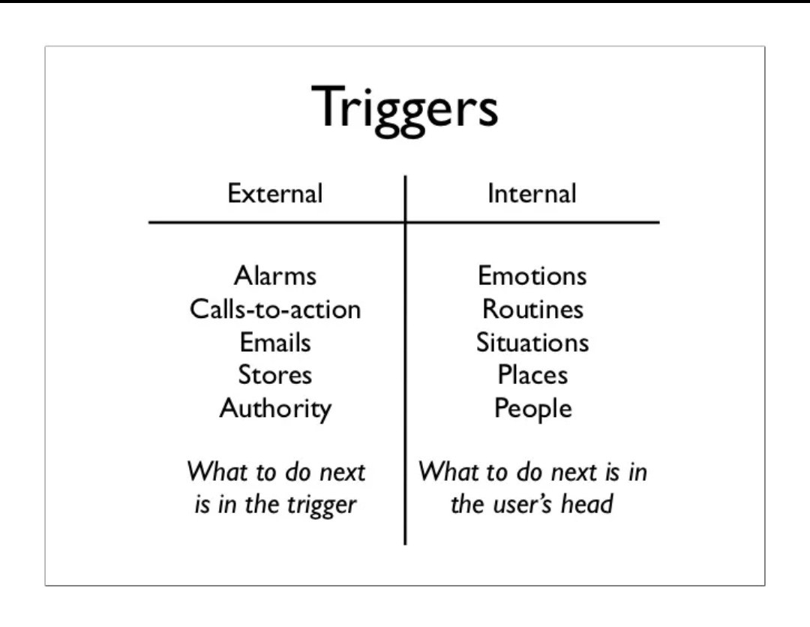
Trigger

Slide 4
Trigger
External
Internal
Paid
Earned
Owned
Relationship

Slide 5
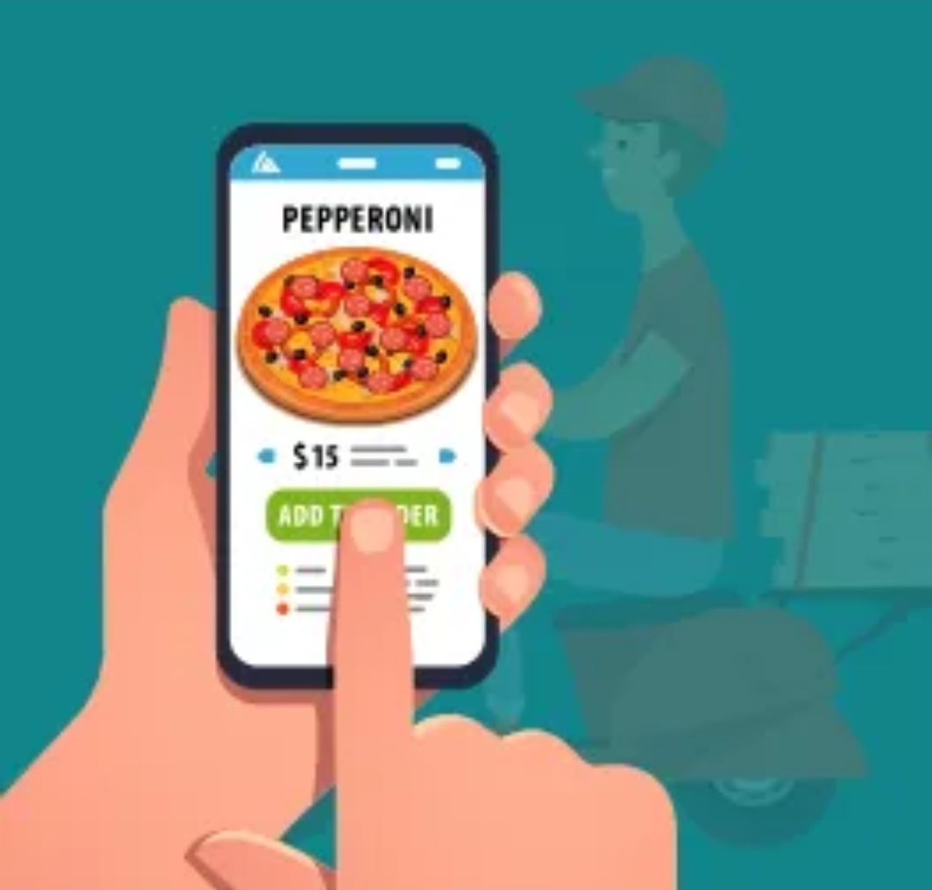
Action

Slide 6



Variable reward
Rewards of the Tribe
Rewards of the self
Rewards of the Hunt

Slide 7

Investment

Slide 8


